Slide 1
BOOTH ALGORITHM
AMRITA BHATNAGAR

Slide 2
Multiplication Algorithm in 2’s Complement Representation
As in all multiplication schemes, booth algorithm requires examination of the multiplier bits and shifting of the partial product. Prior to the shifting, the multiplicand may be added to the partial product, subtracted from the partial product, or left unchanged according to following rules:
The multiplicand is subtracted from the partial product upon encountering the first least significant 1 in a string of 1’s in the multiplier
The multiplicand is added to the partial product upon encountering the first 0 (provided that there was a previous ‘1’) in a string of 0’s in the multiplier.
The partial product does not change when the multiplier bit is identical to the previous multiplier bit.

Slide 3
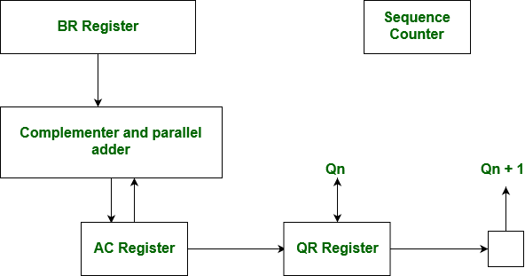
Hardware Implementation

Slide 4
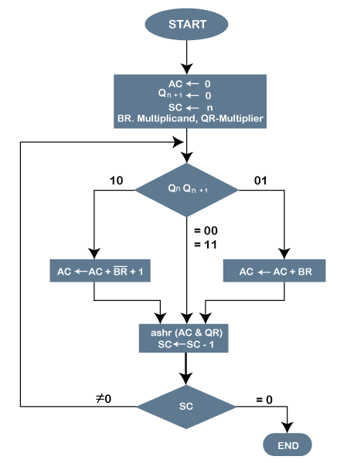
Flow Chart

Slide 5
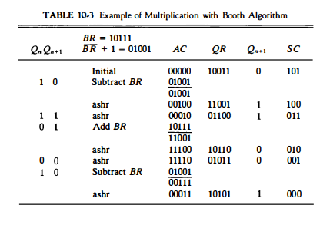

Slide 6
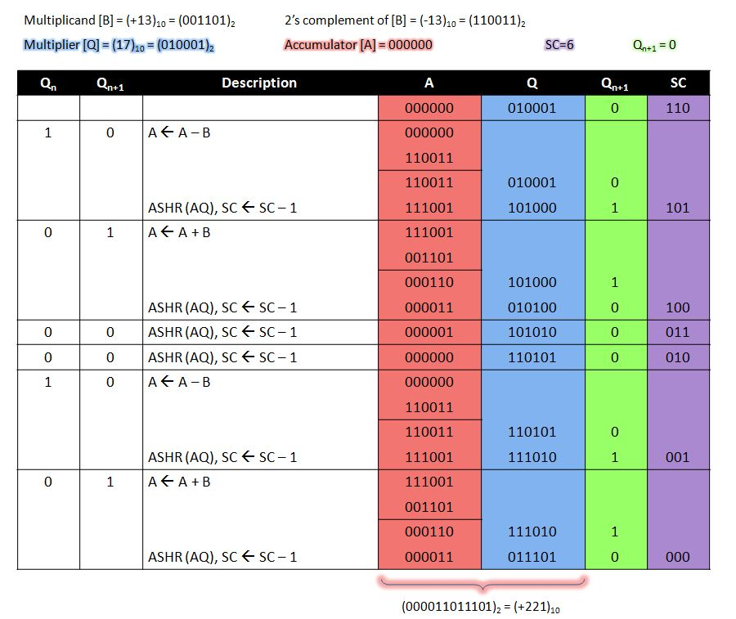

Slide 7
Example – A numerical example of booth’s algorithm is shown below for n = 4. It shows the step by step multiplication of -5 and -7.
MD = -5 = 1011, MD = 1011, MD'+1 = 0101
MR = -7 = 1001
The explanation of first step is as follows: Qn+1
AC = 0000, MR = 1001, Qn+1 = 0, SC = 4
Qn Qn+1 = 10
So, we do AC + (MD)'+1, which gives AC = 0101
On right shifting AC and MR, we get
AC = 0010, MR = 1100 and Qn+1 = 1

Slide 8
PERATION | AC | MR | QN+1 | SC
 | 0000 | 1001 | 0 | 4
AC + MD’ + 1 | 0101 | 1001 | 0
ASHR | 0010 | 1100 | 1 | 3
AC + MR | 1101 | 1100 | 1
ASHR | 1110 | 1110 | 0 | 2
ASHR | 1111 | 0111 | 0 | 1
AC + MD’ + 1 | 0010 | 0011 | 1 | 0

Slide 9
Practice Questions
1.Multiply decimal +5 by decimal +4using booth algorithm with four bit register.
2. Multiply decimal +5 by decimal -4 using booth algorithm with four bit register.
3. Multiply decimal -5 by decimal -4using booth algorithm with four bit register.
4. Multiply decimal -5 by decimal + 4using booth algorithm with four bit register.

Slide 10
Practice Questions
Show the step by step multiplication process using BOOTH algorithm when the following numbers are multiplied.Assume 5 -bit registers that hold signed numbers. The multiplicand is both cases is
(-12) x(-11)
(+10) x(-14)

Slide 11
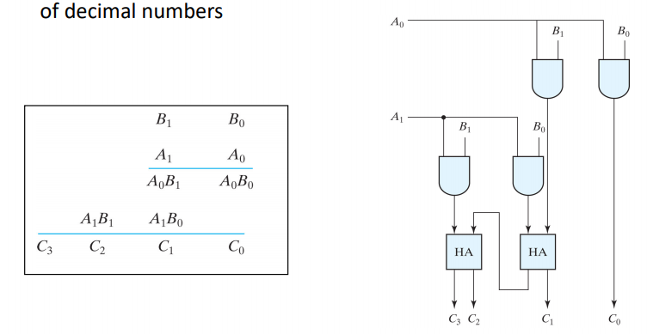
Array Multiplier

Slide 12
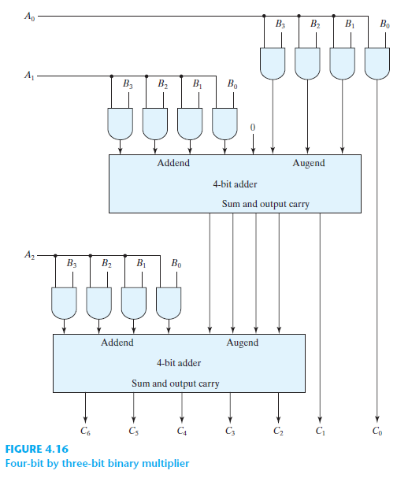
4-Bit by 3-Bit Array Multiplier

Slide 13
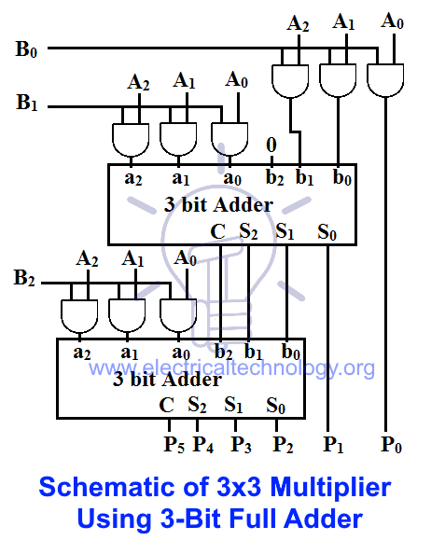

Slide 14
Practice Questions
Design 3 bit by 3 bit array multiplier

