Slide 1
QUEUE

Slide 2
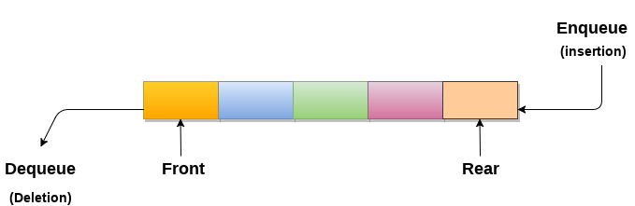
What is Queue?
A queue can be defined as an ordered list which enables insert operations to be performed at one end called REAR and delete operations to be performed at another end called FRONT.
Queue is referred to be as First In First Out list.
For example, people waiting in line for a rail ticket form a queue.

Slide 3
Applications of Queue
Queues are widely used as waiting lists for a single shared resource like printer, disk, CPU.
Queues are used in asynchronous transfer of data (where data is not being transferred at the same rate between two processes) for eg. pipes, file IO, sockets.
Queues are used as buffers in most of the applications like MP3 media player, CD player, etc.
Queue are used to maintain the play list in media players in order to add and remove the songs from the play-list.
Queues are used in operating systems for handling interrupts.

Slide 4
FIFO Principle of Queue:
A Queue is like a line waiting to purchase tickets, where the first person in line is the first person served. (i.e. First come first serve).
Position of the entry in a queue ready to be served, that is, the first entry that will be removed from the queue, is called the front of the queue(sometimes, head of the queue),
similarly, the position of the last entry in the queue, that is, the one most recently added, is called the rear (or the tail) of the queue. See the below figure.
Ex- 0 1 2 3 4 5
Hear Rear = -1 and front = -1
Queue is empty

Slide 5
1- Insert element in queue i.e --- A
0 1 2 3 4 5
Now Rear = 0 and front =0 [ when we insert first element both rear and front are changed]
2- Insert element in queue i.e --- B
0 1 2 3 4 5
Now Rear = 1 and front =0 [increase only rear ]
3-Insert element in queue i.e--- C D E F
0 1 2 3 4 5
Now Rear = 5 (Max size of queue) and front =0
Now We can’t insert element in queue because queue is full----------- Rear = maxsize-1
If(Rear = maxsize-1) QUEUE ID OVERFLOW
A
A | B
A | B | C | D | E | F

Slide 6
Characteristics of Queue:
1- Queue can handle multiple data.
2- We can access both ends.
3- They are fast and flexible.
Queue Representation:
Like stacks, Queues can also be represented in an array: In this representation, the Queue is implemented using the array. Variables used in this case are
Queue: the name of the array storing queue elements.
Front: the index where the first element is delete in the array representing the queue.
Rear: the index where the last element is stored in an array representing the queue.

Slide 7
Types of queue
1- Simple Queue or Linear Queue
2- Circular Queue
3- Priority Queue
4- Double Ended Queue (or Deque)

Slide 8
Simple Queue or Linear Queue
The major drawback of using a linear Queue is that insertion is done only from the rear end.
If the first three elements are deleted from the Queue, we cannot insert more elements even though the space is available in a Linear Queue. In this case, the linear Queue shows the overflow condition as the rear is pointing to the last element of the Queue.
Ex- 0 1 2 3 4 5 6
F R
Front= 3 and rear = 6(max-1)---------- Queue if Full
 |  |  | D | E | F | G

Slide 9
Operations performed on queue
The fundamental operations that can be performed on queue are listed as follows -
Enqueue: The Enqueue operation is used to insert the element at the rear end of the queue. It returns void.
Dequeue: It performs the deletion from the front-end of the queue. It also returns the element which has been removed from the front-end. It returns an integer value.
Peek: This is the third operation that returns the element, which is pointed by the front pointer in the queue but does not delete it.
Queue overflow (isfull): It shows the overflow condition when the queue is completely full.
Queue underflow (isempty): It shows the underflow condition when the Queue is empty, i.e., no elements are in the Queue.

Slide 10
Queue
C Function
Enqueue insert an element– Algo.
void insert()
{
int item;
if(rear == MAX - 1){
printf("Queue Overflow n");
}else{
if(front== - 1){
front = 0;
printf("Inset the element in queue : ");
scanf("%d", &item);
rear = rear + 1;
queue_array[rear] = item;
}
}
Insert(queue,max front,rear,item)
1- if rear= max-1
then write queue is overflow and exit
2- if rear= -1 then set rear=0
else rear = rear+1
3- queue[rear]=item
4- stop

Slide 11
Queue
C Function
Dequeue delete an element– Algo.
void delete()
{
if(front == - 1 )
{
printf("Queue Underflow n");
return;
}
else
{
printf("Element deleted from queue is : %dn", queue[front]);
front = front + 1;
}
}
delete(queue,max front,rear,item)
1- if Front=-1 or front >rear
then write queue if underflow and exit
2- item=queue[front]
3- if front= rear[ it means that queue has only one element
else front=front+1
4- stop

Slide 12
Queue
C Function
Display– Algo.
void display()
{
int i;
if(front == - 1)
printf("Queue is empty n");
else
{
printf("Queue is : n");
for(i = front; i <= rear; i++)
printf("%d ", queue_array[i]);
printf("n");
}
}
display(queue, front, rear)
1- if Front=-1 or front >rear
then write queue queue is empty and exit
2- Repeate step 3 while front<=rear
3- print value of queue[i]
4- stop

Slide 13
Application of queue
A queue is used in scheduling processes in a CPU.
It is used in data transfer between processes.
It holds multiple jobs which are then called when needed.
DFS
Spooling
Advantages of queue:--
. Shows in previous slide
Disadvantage of queue:-

Slide 14
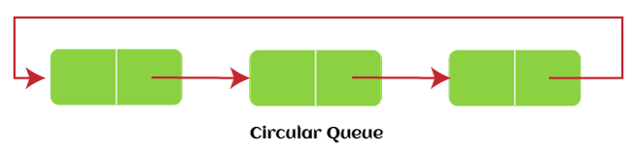
Circular Queue
In Circular Queue, all the nodes are represented as circular. It is similar to the linear Queue except that the last element of the queue is connected to the first element. It is also known as Ring Buffer, as all the ends are connected to another end. The representation of circular queue is shown in the below image –
The drawback that occurs in a linear queue is overcome by using the circular queue. If the empty space is available in a circular queue, the new element can be added in an empty space by simply incrementing the value of rear. The main advantage of using the circular queue is better memory utilization.

Slide 15
Enqueue operation
The steps of enqueue operation are given below:
First, we will check whether the Queue is full or not.
Initially the front and rear are set to -1. When we insert the first element in a Queue, front and rear both are set to 0.
When we insert a new element, the rear gets incremented, i.e., rear=rear+1.
Scenarios for inserting an element
There are two scenarios in which queue is not full:
If rear != max - 1, then rear will be incremented to mod(maxsize) and the new value will be inserted at the rear end of the queue.
If front != 0 and rear = max - 1, it means that queue is not full, then set the value of rear to 0 and insert the new element there.
There are two cases in which the element cannot be inserted:
When front ==0 && rear = max-1, which means that front is at the first position of the Queue and rear is at the last position of the Queue.
front== rear + 1;

Slide 16
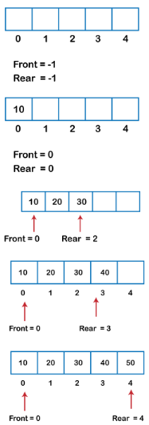
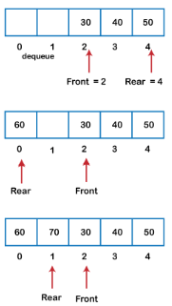
Algorithm to insert an element in a circular queue
Step 1: IF (REAR+1)%MAX = FRONT
Write " OVERFLOW "
Goto step 4
[End OF IF]
Step 2: IF FRONT = -1 and REAR = -1
SET FRONT = REAR = 0
ELSE IF REAR = MAX - 1 and FRONT ! = 0
SET REAR = 0
ELSE
SET REAR = (REAR + 1) % MAX
[END OF IF]
Step 3: SET QUEUE[REAR] = VAL
Step 4: EXIT

Slide 17
void enqueue(int element)
{
if(front==-1 && rear==-1) // condition to check queue is empty
{
front=0;
rear=0;
queue[rear]=element;
}
else if((rear+1)%max==front) // condition to check queue is full
{
printf("Queue is overflow..");
}
else
{
rear=(rear+1)%max; // rear is incremented
queue[rear]=element; // assigning a value to the queue at the rear position.
}
}

Slide 18
Dequeue Operation
The steps of dequeue operation are given below:
First, we check whether the Queue is empty or not. If the queue is empty, we cannot perform the dequeue operation.
When the element is deleted, the value of front gets decremented by 1.
If there is only one element left which is to be deleted, then the front and rear are reset to -1.
Algorithm to delete an element from the circular queue
Step 1: IF FRONT = -1
Write " UNDERFLOW "
Goto Step 4
[END of IF]
Step 2: SET VAL = QUEUE[FRONT]
Step 3: IF FRONT = REAR
SET FRONT = REAR = -1
ELSE
IF FRONT = MAX -1
SET FRONT = 0
ELSE
SET FRONT = FRONT + 1
[END of IF]
[END OF IF]
Step 4: EXIT
int dequeue()
{
if((front==-1) && (rear==-1)) // condition to check queue is empty
{
printf("\nQueue is underflow..");
}
else if(front==rear)
{
printf("\nThe dequeued element is %d", queue[front]);
front=-1;
rear=-1;
}
else
{
printf("\nThe dequeued element is %d", queue[front]);
front=(front+1)%max;
}
}

Slide 19
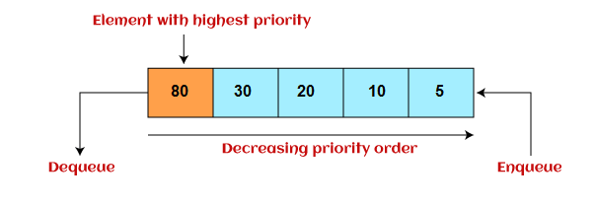
Priority Queue
It is a special type of queue in which the elements are arranged based on the priority. It is a special type of queue data structure in which every element has a priority associated with it. Suppose some elements occur with the same priority, they will be arranged according to the FIFO principle. The representation of priority queue is shown in the below image –
Insertion in priority queue takes place based on the arrival, while deletion in the priority queue occurs based on the priority.
Priority queue is mainly used to implement the CPU scheduling algorithms.

Slide 20
There are two types of priority queue that are discussed as follows –
Ascending priority queue - In ascending priority queue, elements can be inserted in arbitrary order, but only smallest can be deleted first. Suppose an array with elements 7, 5, and 3 in the same order, so, insertion can be done with the same sequence, but the order of deleting the elements is 3, 5, 7.
Descending priority queue - In descending priority queue, elements can be inserted in arbitrary order, but only the largest element can be deleted first. Suppose an array with elements 7, 3, and 5 in the same order, so, insertion can be done with the same sequence, but the order of deleting the elements is 7, 5, 3.

Slide 21
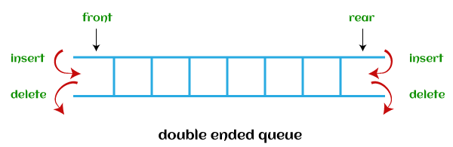
Deque (or, Double Ended Queue)
In Deque or Double Ended Queue, insertion and deletion can be done from both ends of the queue either from the front or rear. It means that we can insert and delete elements from both front and rear ends of the queue. Deque can be used as a palindrome checker means that if we read the string from both ends, then the string would be the same.
Deque can be used both as stack and queue as it allows the insertion and deletion operations on both ends. Deque can be considered as stack because stack follows the LIFO (Last In First Out) principle in which insertion and deletion both can be performed only from one end. And in deque, it is possible to perform both insertion and deletion from one end, and Deque does not follow the FIFO principle.

Slide 22
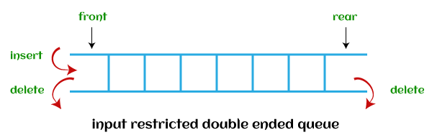
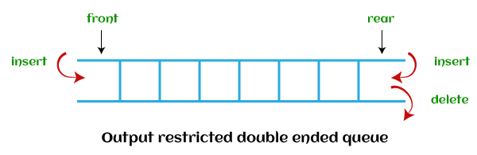
There are two types of deque that are discussed as follows -
1- Input restricted deque - As the name implies, in input restricted queue, insertion operation can be performed at only one end, while deletion can be performed from both ends.
2- Output restricted deque - As the name implies, in output restricted queue, deletion operation can be performed at only one end, while insertion can be performed from both ends.

Slide 23
1- Input restricted deque –
Insert an element at rear
Delete an element from front
Delete an element from rear
2- Output restricted deque –
Insert an element at rear
Delete an element from front
Insert an element from front
 | Insertion | Deletion
Front side | F= F-1 | F=F+1
Rear side | R = R+1 | R=R-1

Slide 24
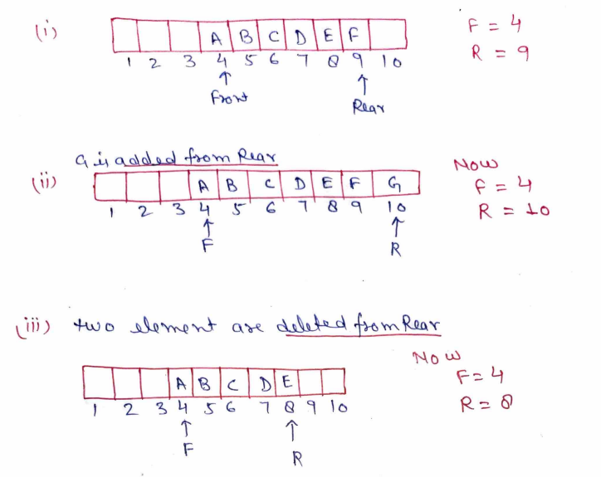
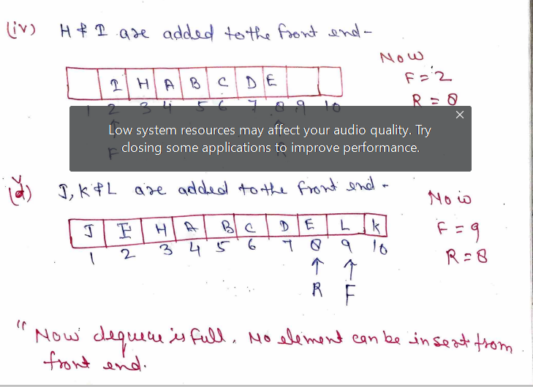
Deque representation

Slide 25
iii- Delete an element from rear
void delete(){
if (rear==-1){
printf(“Dequeue is empty \n”);
}
else{
item= Dq[Rear]
printf(“\n The item %D is deleted”,item);
}
If (front== rear){
front=-1; rear=-1;
}else if (rear==0){
rear=max-1;
else{
rear=rear-1;
}
}

Slide 26
Insert from Front--
Void insert(){
if ((f==0 && r==max-1)II (f=r+1){
printf(“ \n\n Overflow\n”);
}else{
if( f==-1){
r=0; f=0;
}else if (f==0){
f=max-1;
}else{
f=f-1;
printf(Enter element to be inserted”);
scanf(“%d”, element);
Dq[f] = item;
printf(“Element inserted”);
}
}
}

Slide 27
Difference Between Recursion and Iteration
SNO | On the basis of | Recursion | Iteration
1 | Basic | Recursion is the process of calling a function itself within its own code. | In iteration, there is a repeated execution of the set of instructions. In Iteration, loops are used to execute the set of instructions repetitively until the condition is false.
2 | Syntax | There is a termination condition is specified. | The format of iteration includes initialization, condition, and increment/decrement of a variable.
3 | Termination | The termination condition is defined within the recursive function. | Here, the termination condition is defined in the definition of the loop.
4 | Applied | It is always applied to functions. | It is applied to loops.
5 | Speed | It is slower than iteration. | It is faster than recursion.
6 | Memory | It uses more memory as compared to iteration. | It uses les
7 | Code size | The code size in recursion is smaller than the code size in iteration. | The code size in iteration is larger than the code size in recursion.

Slide 28
Recursion
Iteration
// method to find factorial of given number
int factorialUsingRecursion(int n)
{
if (n == 0)
return 1;
// recursion call
return n * factorialUsingRecursion(n - 1);
}
// Method to find the factorial of a given number
int factorialUsingIteration(int n)
{
int res = 1, i;
// using iteration
for (i = 2; i <= n; i++)
res *= i;
return res;
}

Slide 29
int main()
{
int num = 5;
printf(“%d Factorial of a number using Recursion is: " ,
factorialUsingRecursion(5);
printf(“%d Factorial of a number using Recursion is: " ,
factorialUsingIteration(5);
return 0;
}

Slide 30
Types of recursion
1- Direct Recursion--- When a function calls itself within the same function repeatedly, it is called the direct recursion.
2- Indirect Recursion
3- Tail Recursion
4- No Tail/ Head Recursion
5- Linear recursion
6- Tree Recursion

Slide 31
Types of recursion
1- Direct Recursion--- When a function calls itself within the same function repeatedly, it is called the direct recursion.
fun ( )
{
fun( );
}
Ex Fibonacci series
2- Indirect Recursion- When a function is mutually called by another function in a circular manner, the function is called an indirect recursion function.
fun1 ( )
{
fun2( );
}
fun2 ( )
{
fun1( );
}

Slide 32
3- Tail Recursion-- A recursive function is called the tail-recursive if the function makes recursive calling itself, and that recursive call is the last statement executes by the function. After that, there is no function or statement is left to call the recursive function.
#include <stdio.h>
// function definition
void fun1(int num)
{
if (num == 0)
return ;
else
printf ("\n Number is: %d", num); // print the number
return fun1 (num - 1); // recursive call at the end in the fun() function
}
int main ()
{
fun1(10); // pass 10 as integer argument
return 0;
}

Slide 33
Fibonacci Series
#include<stdio.h> int fibo_num (int i) { // if the num i is equal to 0, return 0; if ( i == 0) { return 0; } if ( i == 1) { return 1; } return fibo_num (i - 1) + fibo_num (i -2); } | int main () { int i; // use for loop to get the first 10 fibonacci series for ( i = 0; i < 10; i++) { printf (" %d \t ", fibo_num (i)); } return 0; }

Slide 34
Tower Of Hanoi
The tower of Hanoi is a mathematical puzzle. It consists of three rods and a number of disks of different sizes which can slide to any rod. The puzzle starts with the disks in a neat stack in ascending order of size on one rod, the smallest at the top. We have to obtain the same stack on the third rod.
The objective of the puzzle is to move the entire stack to another rod, obeying the following simple rules−
Only one disk can be moved at a time.
Each move consists of taking the upper disk from one of the stacks and placing it on top of another stack i.e. a disk can only be moved if it is the uppermost disk on a stack.

Slide 35
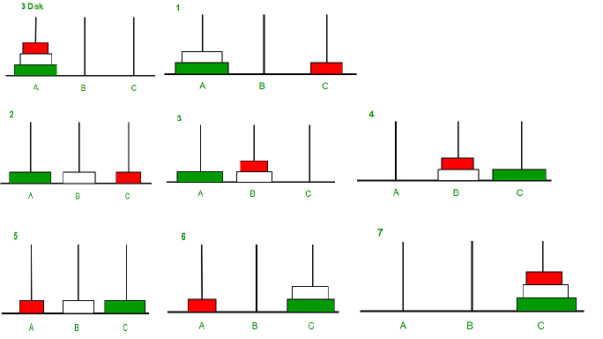

Slide 36
#include<stdio.h>
void TOH(int n,char x,char y,char z)
{
if(n>0) {
TOH(n-1,x,z,y);
printf("\n%c to %c",x,y);
TOH(n-1,z,y,x);
}
}
int main()
{
int n;
printf("enter the value of n");
scanf("%d",&n);
TOH(n,'A','B','C');
}

