Slide 1
STACK

Slide 2

A Stack is a linear data structure that follows the LIFO (Last-In-First-Out) principle.
It contains only one pointer top pointer pointing to the topmost element of the stack.
A stack can be defined as a container in which insertion and deletion can be done from the one end known as the top of the stack.
Some key points related to stack
It is called as stack because it behaves like a real-world stack, piles of books, etc.
A Stack is an abstract data type with a pre-defined capacity, which means that it can store the elements of a limited size.
It is a data structure that follows some order to insert and delete the elements, and that order can be LIFO or FILO.

Slide 3
Standard Stack Operations
The following are some common operations implemented on the stack:
push(): When we insert an element in a stack then the operation is known as a push. If the stack is full then the overflow condition occurs.
pop(): When we delete an element from the stack, the operation is known as a pop. If the stack is empty means that no element exists in the stack, this state is known as an underflow state.
isEmpty(): It determines whether the stack is empty or not.
isFull(): It determines whether the stack is full or not.’
peek(): It returns the element at the given position.
count(): It returns the total number of elements available in a stack.
change(): It changes the element at the given position.
display(): It prints all the elements available in the stack.

Slide 4
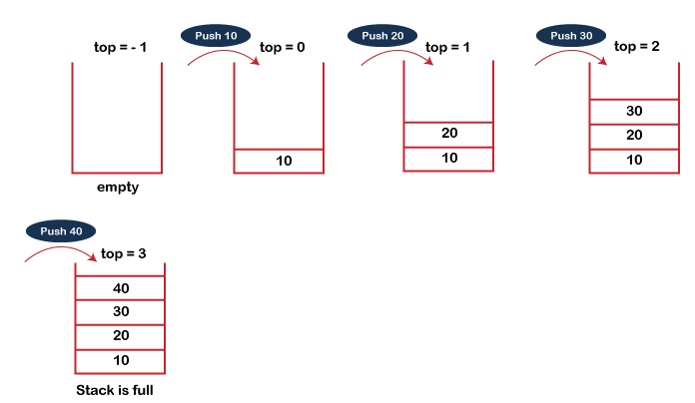
PUSH operation
The steps involved in the PUSH operation is given below:
Before inserting an element in a stack, we check whether the stack is full.
If we try to insert the element in a stack, and the stack is full, then the overflow condition occurs.
When we initialize a stack, we set the value of top as -1 to check that the stack is empty.
When the new element is pushed in a stack, first, the value of the top gets incremented, i.e., top=top+1, and the element will be placed at the new position of the top.
The elements will be inserted until we reach the max size of the stack.

Slide 5
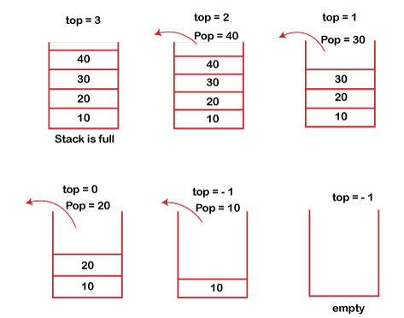
POP operation
The steps involved in the POP operation is given below:
Before deleting the element from the stack, we check whether the stack is empty.
If we try to delete the element from the empty stack, then the underflow condition occurs.
If the stack is not empty, we first access the element which is pointed by the top
Once the pop operation is performed, the top is decremented by 1, i.e., top=top-1.

Slide 6
Array implementation of Stack
PUSH Operation
POP Operation
begin
if top = n then stack full
top = top + 1
stack (top) : = item;
end
begin
if top = 0 then stack empty;
item := stack(top);
top = top - 1;
end;
void push (int val,int n) //n is size of the stack
{
if (top == n )
printf("\n Overflow");
else
{
top = top +1;
stack[top] = val;
}
}
int pop ()
{
if(top == -1)
{
printf("Underflow");
return 0;
}
else
{
return stack[top - - ];
}
}

Slide 7
Array implementation of Stack
Visiting each element of the stack (Peek operation)
Begin
if top = -1 then stack empty
item = stack[top]
return item
End
int peek()
{
if (top == -1)
{
printf("Underflow");
return 0;
}
else
{
return stack [top];
}
}

Slide 8
Array implementation of Stack
#include <stdio.h>
int stack[100],i,j,choice=0,n,top=-1;
void push();
void pop();
void show();
void main () {
printf("Enter the number of elements in the stack ");
scanf("%d",&n);
printf("*********Stack operations using array*********");
printf("\n----------------------------------------------\n");
while(choice != 4) {
printf("Chose one from the below options...\n");
printf("\n1.Push\n2.Pop\n3.Show\n4.Exit");
printf("\n Enter your choice \n");
scanf("%d",&choice);
switch(choice){
case 1:
push();
break;
case 2:
pop();
break;
case 3:
show();
break;
case 4:
printf("Exiting....");
break;
default:
printf("Please Enter valid choice ");
}
}
}
void push () {
int val;
if (top == n )
printf("\n Overflow");
else {
printf("Enter the value?");
scanf("%d",&val);
top = top +1;
stack[top] = val;
}
}
void pop () {
if(top == -1)
printf("Underflow");
else
top = top -1;
}
void show()
{
for (i=top;i>=0;i--)
{
printf("%d\n",stack[i]);
}
if(top == -1)
{
printf("Stack is empty");
}
}

Slide 9
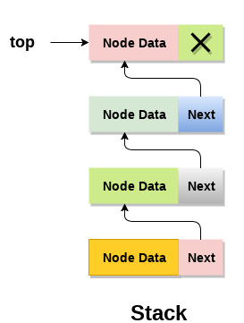
Linked list implementation of stack
void push ()
{
int val;
struct node *ptr =(struct node*)malloc(sizeof(struct node));
if(ptr == NULL)
{
printf("not able to push the element");
}
else
{
printf("Enter the value");
scanf("%d",&val);
if(head==NULL)
{
ptr->val = val;
ptr -> next = NULL;
head=ptr;
}
else
{
ptr->val = val;
ptr->next = head;
head=ptr;
}
printf("Item pushed");
}
}

Slide 10
Linked list implementation of stack
void pop()
{
int item;
struct node *ptr;
if (head == NULL)
{
printf("Underflow");
}
else
{
item = head->val;
ptr = head;
head = head->next;
free(ptr);
printf("Item popped");
}
}

Slide 11
Application Of Stack
Arithmetic Expression (The Arithmetic expression involves OPERENDS and OPERATORS)
Infix Expression
Postfix Expression (Reverse Polish Notation)
Prefix Expression ( Polish Notation)
Operator Precedence
Operators | Symbols
Parenthesis | ( ), {}, [ ]
Exponents | ^
Multiplication and Division | *, /
Addition and Subtraction | + , -

Slide 12
Application Of Stack
Arithmetic Expression (The Arithmetic expression involves OPERENDS and OPERATORS)
Infix Expression
Postfix Expression (Reverse Polish Notation)
Prefix Expression ( Polish Notation)
Operator Precedence
Operend 1 / Operator / Operend 2
Example:-
A+B
(A+B)*(B+C)
((A+B)/E)*(D+F)
Operators | Symbols
Parenthesis | ( ), {}, [ ]
Exponents | ^
Multiplication and Division | *, /
Addition and Subtraction | + , -

Slide 13
Application Of Stack
Arithmetic Expression (The Arithmetic expression involves OPERENDS and OPERATORS)
Infix Expression
Postfix Expression (Reverse Polish Notation)
Prefix Expression ( Polish Notation)
Operator Precedence
Operend 1 / Operend 2 / Operator
Example:-
AB+
AB+BC+*
AB+E/DF+*
Operators | Symbols
Parenthesis | ( ), {}, [ ]
Exponents | ^
Multiplication and Division | *, /
Addition and Subtraction | + , -

Slide 14
Application Of Stack
Arithmetic Expression (The Arithmetic expression involves OPERENDS and OPERATORS)
Infix Expression
Postfix Expression (Reverse Polish Notation)
Prefix Expression ( Polish Notation)
Operator Precedence
Operator / Operend 1 / Operend 2
Example:-
+AB
*+AB+BC
*/+ABE+DF
Operators | Symbols
Parenthesis | ( ), {}, [ ]
Exponents | ^
Multiplication and Division | *, /
Addition and Subtraction | + , -

Slide 15
INFIX, POSTFIX & PREFIX
Q1). A – B – D * E / F + B * C
POSTFIX
A – B – DE* / F + BC*
A – B – DE*F/ + BC*
AB- - DE*F/ + BC*
AB- DE*F/- + BC*
AB- DE*F/- BC*+
PREFIX
A – B - *DE / F + *BC
A – B - /* DEF + *BC
-AB -/*DEF +*BC
--AB /*DEF +*BC
+--AB/*DEF*BC

Slide 16
Q2). (A + B) * C – (D * E) – (F + G)
POSTFIX
AB – C * DE * - FG + -
PREFIX
- - * + ABC * DE +FG
Q3). (A + (B – C)) * ((D – E) / ( F + G – H))
POSTFIX
A B C - + D E - F G + H - / *
PREFIX
* + A - B C / - D E + F G - H

Slide 17
INFIX, POSTFIX & PREFIX USING STACK
Q1). (A+(B*C)/D)
SNO | SYMBOL | STACK | EXPRESSION
1 | ( | ( | ----------
2 | A | ( | A
3 | + | (+ | A
4 | ( | (+( | A
5 | B | (+( | AB
6 | * | (+(* | AB
7 | C | (+(* | ABC
8 | ) | (+ | ABC*
9 | / | (+/ | ABC*
10 | D | (+/ | ABC*D
11 | ) | ------- | ABC*D/+

Slide 18
SNO | SYMBOL | STACK | EXPRESSION
1 | ( | ( | ---------------------
2 | A | ( | A
3 | + | (+ | A
4 | ( | (+( | A
5 | B | (+( | AB
6 | * | (+(* | AB
7 | C | (+(* | ABC
8 | - | (+(- | ABC*
9 | ( | (+(-( | ABC*
10 | D | (+(-( | ABC*D
11 | / | (+(-(/ | ABC*D
12 | E | (+(-(/ | ABC*DE
13 | ^ | (+(-(/^ | ABC*DE
14 | F | (+(-(/^ | ABC*DEF
15 | ) | (+(- | ABC*DEF^/
16 | * | (+(-* | ABC*DEF^/
17 | G | (+(-* | ABC*DEF^/G
18 | ) | (+ | ABC*DEF^/G*-
19 | * | (+* | ABC*DEF^/G*-
20 | H | (+* | ABC*DEF^/G*-H
21 | ) | ------- | ABC*DEF^/G*-H*+
Q2). (A + (B* C – ( D/E^F)*G)*H)

Slide 19
Algorithm of Evaluation of a postfix expression
Initialize an empty stack to store operands.
Scan the postfix expression from left to right, token by token.
For each token:
  If the token is an operand (i.e., a number or variable):
    Push it onto the stack.
  If the token is an operator (e.g., +, -, *, /, ^):
    Pop two operands from the stack.
      Let the first popped element be the second operand.
      Let the second popped element be the first operand.
    Apply the operator to the two operands in the order:
      result = first operand operator second operand
    Push the result of the operation back onto the stack.
After the entire expression has been scanned, the stack will contain exactly one element, which is the result of the postfix expression.
Return the result from the stack (i.e., the final result).

Slide 20
Solve the following postfix expression
P: 5 6 2 + * 12 4 / -
SYMBOL | STACK
5 | 5
6 | 5 6
2 | 5 6 2
+ | 5 8
* | 40
12 | 40 12
4 | 40 12 4
/ | 40 3
- | 37

Slide 21
Solve the following postfix expression
P: 12 7 3 - / 2 1 5 + * +
SYMBOL | STACK
12 | 12
7 | 12 7
3 | 12 7 3
- | 4
/ | 3
2 | 3 2
1 | 3 2 1
5 | 2 1 5
+ | 3 2 6
* | 12
+ | 15

